Slide 1

Project Phase 3
Checkers
By CS 301 Group 1
Notes:
Zayd starts by introducing himself then Noor and Hasib follows

Slide 2

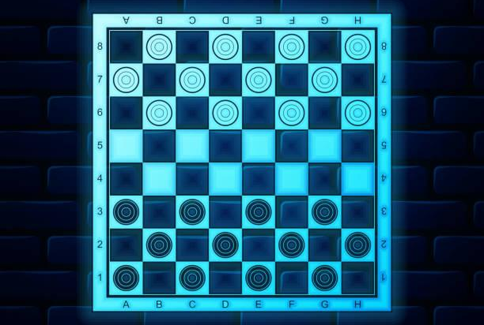
Project Description
Development Details
Main Strength of the project
Testing Phase
Project Demo
Members Contribution
What we learned from this project?
Table of Contents

Slide 3

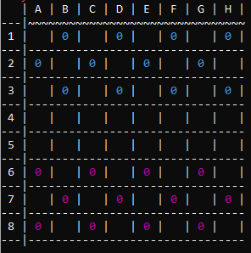
Project Description
A checkers game that utilizes the command prompt in order to play
The player inputs a row number followed by a column letter to select their piece.
The player chooses where they would like to move the piece to on the board
A message is printed with the winning player announced

Slide 4
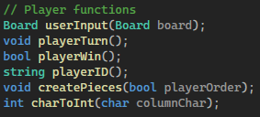
Development Details
Player Object:
Alternating player turns (playerTurn).
Handling user input and updating the board (userInput).
Creating player pieces (createPieces).
Converting character to integer for columns (charToInt).

Slide 5
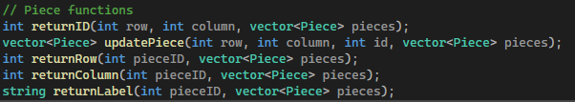
Development Details
Piece Object:
Returning the ID of a piece (returnID).
Updating the position of a piece (updatePiece).

Slide 6
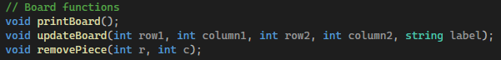
Development Details
Board Object:
Printing the board to the console (printBoard).
Updating the position of pieces on the board (updateBoard).
Removing a piece from the board (removePiece).

Slide 7
Main Strength of the project
For the user:
The board looks good
The simple inputs and instructions required
For the coder:
Every variable is important and keeps track of something specific
Functions are called in a way that makes sense to update the respective variables

Slide 8
Testing Phase
Managing growing containers was a significant challenge during testing
Keeping track of different variables for each object was also challenging
Program was tested after each small addition to the code.
Testers' feedback played a crucial role in refining user experience.

Slide 9

Project Demo

Slide 10
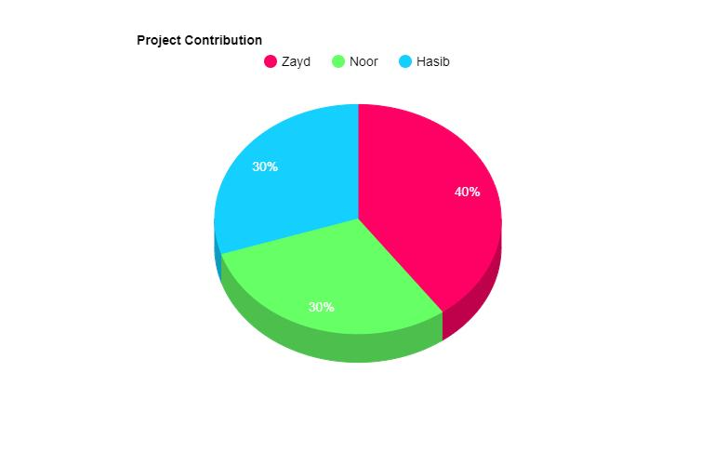
Members Contribution
Zayd:
Player object
Main program
Ensure every element works together in the program
Noor:
Board object
Formatting the board and making it look nice
Updating board properly
Hasib:
Piece object
Keeping track of the piece variables
Making sure they update properly

Slide 11

What we learned
Development scope increases in size
Reaching goals in time is neeccersaty
Being familiar with code is needed
Keep track of every function and variable within the program
Working in a team can be difficult

Slide 12
THANK YOU!

